Slide 1
The Functions of Behavior
by Danielle Staropoli, BCBA
ELEOS Family Services

Slide 2
MY PUBLIC APOLOGY
I am a big fan of memes, so for this…. I sincerely apologize
This PowerPoint will be FILLED with them.
I think I am funny.
Please feel free to pretend I am funny and laugh along with me ☺

Slide 3
TODAY’S OBJECTIVES
Review of Foundations of ABA (defining behavior and identifying behaviors to target)
The 4 functions of behavior
ABC recording and analysis
Identifying the function of challenging behavior

Slide 4
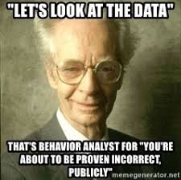
BEHAVIOR
Behavior :
An observable and measurable act of a person
(You can see it or hear it, count it or time it)
Behavior is not:
Feelings or emotions

Slide 5
IS IT BEHAVIOR?
Behavior
Crying
Spitting
Hitting
Rocking
Laughing
Not Behavior
Mad
Anxious
Happy
Agitated
Frustrated

Slide 6
BEHAVIOR
It is important to define behavior in a way that
describes what it looks like,
not what we suspect it means or how we
suspect the person feels.

Slide 7
IDENTIFYING BEHAVIOR TO TARGET FOR REDUCTION
Behavior that is dangerous to child or others
Behavior that interferes with participation in meaningful activities
Behavior that disrupts others and prevents them from participating in meaningful activities
Behavior that is stigmatizing (likely to prevent a child from being included)

Slide 8
THE FUNCTIONS OF BEHAVIOR
WARNING: This is where the memes really start to roll in. Brace yourselves

Slide 9
Discussion
Why do people engage in challenging behavior?
Better yet…….
Why do you and I behave the way we do?

Slide 10
The answer:
It works for us!!
We have learned through our experiences and through conditioning what is effective in getting our needs and desires met.
We also do what we are motivated to do, what we find enjoyable, and what is reinforcing to us.

Slide 11
THE FUNCTIONS OF BEHAVIOR
All behavior serves a purpose
for the person who does it

Slide 12
THE FUNCTIONS OF BEHAVIOR
Behavior is repeated because the consequences are desirable
We engage in behavior in ways that get us what we want, or help us avoid or escape things we don’t want

Slide 13
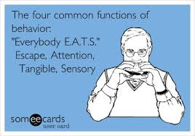
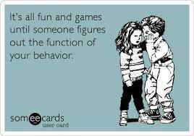
THE 4 FUNCTIONS OF BEHAVIOR
To escape or avoid something
To get attention
To get access to an item or activity (tangible)
Sensory Stimulation

Slide 14
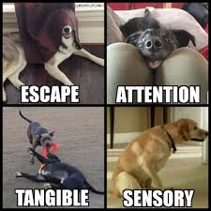
FUNCTIONS OF BEHAVIOR

Slide 15
THE FUNCTIONS OF BEHAVIOR

Slide 16
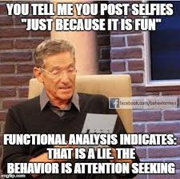
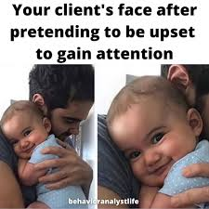
ATTENTION
Behavior that results in immediate attention from others
This can be “positive” or “negative” attention
Examples:
Saying “Excuse me?” and Mom looks at you
Taking your sister’s toy and she chases you
Throwing papers and your teacher yells at you
Crying and mom cuddles you
Running away, and turning to see if teacher is following you

Slide 17
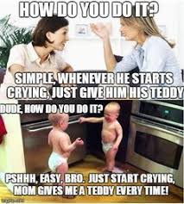
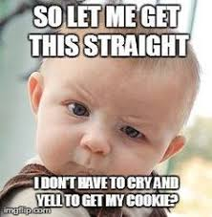
ACCESS TO ITEMS
Behavior that results in getting preferred objects, items, or activities
Examples:
Grabbing a toy from a peer
Asking for a snack or candy
Leaving circle time and going to play with trains
Climbing a cabinet to get a game
Saying “push me higher” and dad pushes you on swing

Slide 18
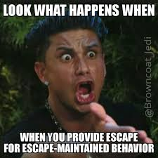
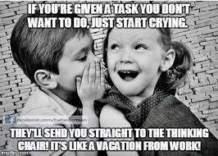
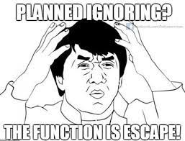
AVOIDANCE/ESCAPE
Behavior that results in ending or delaying disliked events
Examples:
Complete chores; mom stops nagging
Complete assignment; avoid homework later
Hang up phone when telemarketer calls; conversation stops
Flop to the floor; delay coming in from recess
Hit peers; escape group work/circle time
Throw a tantrum; avoid going to the bathroom

Slide 19
SENSORY/ AUTOMATIC
Behaviors that are fun by themselves; they feel good, look fun, smell cool, etc.
Typically things that happen when child is alone or all the time no matter where they are
Examples:
Hand flapping, body rocking, flicking fingers by eyes
Making noises, reciting lines from movies, humming
Spinning wheels on a car, opening and closing door repeatedly, playing with string, banging hangers together
Going for a run, rubbing your temples, twirling your hair, scratching an itch, tapping your foot, fidget spinners

Slide 20
Discussion
Do you engage in any behavior that doesn’t fit in to one of these categories?

Slide 21
Identifying the Function of
Problem Behavior

Slide 22
THE BEHAVIORAL EVENT
To understand behavior, we need to know the whole story (beginning, middle, end)
A description of the behavior alone is not enough.

Slide 23
ABC RECORDING
ANTECEDENT (A) - BEHAVIOR (B) - CONSEQUENCE (C)
ABC data helps identify
The events or conditions that make the target behavior more likely to be exhibited
The events that precede or “trigger” the target behavior.
The consequences that maintain the behavior (the purpose of the behavior; the FUNCTION).

Slide 24
ABC ANALYSIS
Identify the behavior (must be observable and measurable)
Identify the antecedent (what happens directly before the behavior)
Identify the consequence (what happens directly after the behavior)

Slide 25
PRACTICE
Maria is at the table with a classmate and her teacher. Her teacher is talking to her classmate about her her upcoming birthday party. Maria begins to yell, bang on the table, and throw her materials. Her teacher sits down with Maria, holds her hands, and offers reassurance.
Antecedent | Behavior | Consequence
Teacher is talking to a classmate | Maria yells, hits table, throws materials | Teacher sits with her and talks to her
What function would a pattern of behavior like this suggest?

Slide 26
PRACTICE
When Joey is given a math assignment, he gets out of his desk, runs around the room and knocks classmates books and papers on the floor. An administrator is called to remove him from the classroom.
Antecedent | Behavior | Consequence
Given a math assignment | Joey gets up, walks around class throws materials | Removed from class
What function would a pattern of behavior like this suggest?

Slide 27
PRACTICE
Sam tries to run from the cafeteria repeatedly as soon as he finishes his lunch. He is given an iPad and walked back to the table.
Antecedent | Behavior | Consequence
Finishes lunch | Sam attempts to run from cafeteria | Given iPad and returned to table
What function would a pattern of behavior like this suggest?

Slide 28
PRACTICE
When the class starts dribbling basketballs in the gym, Jose sits, covers his ears with his hands, and rocks back and forth.
Antecedent | Behavior | Consequence
Classmates start bouncing basketballs n the gym | Jose sits, covers ears, rocks | Lessens volume of the basketballs
What function would a pattern of behavior like this suggest?

Slide 29
THANK YOU

