Slide 1
ABA:
Here are the Facts…

Slide 2
Applied Behavior Analysis
A methodology for understanding, and ultimately changing, behavior
Based on over 60 years of research
ABA is a highly positive approach that presents concepts in structured and systematic manner
Instructional programs are individualized and developed with a specific criteria, behavioral definition, data collection procedure, and teaching procedure

Slide 3
What many think ABA is ?
Discrete Trial
For “severely impaired students”
Repetitive
Robotic
Data data data
Only used in “special” schools
BORING!
BCSSBEHAVIORANALYSISDPT

Slide 4
What ABA really is
Good Teaching
Curriculum Modification
Pre teaching
Use of Prompts, especially visual supports
Generalization
Behavior Reduction
Behavior Expansion
REINFORCING!!!
BCSSBEHAVIORANALYSISDPT

Slide 5
ABA can be used to support any individual!!
ABA can be used anywhere!!!

Slide 6
ABA Broken Down
Applied – study must examine behavior that has immediate importance to the subject
Behavior – what is targeted to be changed
Analytic – studies demonstrate a functional relation between the manipulated events and the behavior of interest.

Slide 7
ABA vs DTI
Discrete Trial Instruction (DTI) is a method under the umbrella of ABA that breaks tasks down into small (discrete) pieces and utilizes reinforcement procedures so that the student systematically learns the skills
DTI is apart of ABA … they are not synonymous with each other

Slide 8
Key Aspects of ABA
1. Attitudes and methodology of science guide its practice.
2. Procedures are applied in a systematic technological manner.
3. Procedures that are derived from the basic principles of behavior qualify as ABA

Slide 9
Key Aspects of ABA cont’d
4. Focus is on socially significant behavior.
5. Seeks to make meaningful improvement on important behavior
6. Produce a functional analysis of the factors of any improvement

Slide 10
Components of ABA
Functional Analysis of Behavior
Shaping
Data-Based Accountability
Prompts and Prompt Fading
ABA
Applied Behavior Analysis
Generalization and Maintenance
Principles
of
Reinforcement
Discrete Trial Theory
Task Analysis and Chaining
BCSSBEHAVIORANALYSISDPT

Slide 11
ABA Methods
Increase Behaviors/Skills
Teach New Skills
Maintain Skills/Behaviors
Generalize/Transfer Skills/Behaviors
Restrict Conditions under which behaviors occur
Reduce Behaviors

Slide 12
Three Term Contingency
Behavior just does not happen; it happens in relation to other events. The science of ABA seeks to discover the relationships among those events
The history of relationships between these three events determines when a specific behavior occurs and how often
Antecedent – Behavior - Consequence
Notes:
The universe is a determined, orderly place in which things just don’t happen. There is always a reason for behavior, whether we can see it or not.
Basic – Teacher asks a student a question – student answers – teacher says good job
Everything we do is in relation to a 3 term contingency

Slide 13
Antecedents
An antecedent is an event that occurs before a behavior that may result in the behavior starting, increasing, decreasing, or stopping
Antecedents may be external or internal
Examples of antecedents include instructions, signs, objects, prompts, people/events, and internal states
An event is an antecedent only if it is likely to result in the occurrence or non-occurrence of a response

Slide 14
Behavior
Behavior refers to what someone does in the presence of/or following a particular antecedent response
Response could be both adaptive and maladaptive
Must be observable and measurable

Slide 15
Consequence
A consequence refers to events that occur after a behavior
A consequence is a stimulus that may include the person’s external environment, internal state, or natural event
Affects the future probability of an occurrence of a behavior (history of reinforcement/punishment).
Consistency providing certain types of consequences to specific behaviors will strengthen or weaken the probability of occurrence of a behavior over time

Slide 16
Consequences
Reinforcement
    Positive Reinforcement
    Negative Reinforcement
Punishment
    Type I (Positive)
    Type II (Negative)

Slide 17
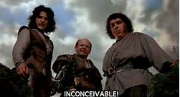
I do not think that means what you think it means….
Reinforcement
Negative vs. Positive Reinforcement
Punishment
Prompt

Slide 18
Reinforcement
Reinforcement – when a behavior is followed immediately by the presentation or removal of a stimulus and, as a result, the behavior is more likely to occur in the future.
(Thorndike’s Law of Effect)
  Positive vs. negative
  differential reinforcement
Notes:
Differential reinforcement→ selectively reinforcing behaviors you want to see increase and “ignoring” (aka extinction) the behaviors you want to see decrease (this is often used as a schedule of reinforcement)

Slide 19
Reinforcement cont’d
Positive Reinforcement
Addition of stimulus after a behavior has occurred that will increase the behavior in the future.
Negative Reinforcement
Removal of a stimulus after a behavior has occurred that will increase the behavior in the future.
Notes:
Reinforcement increases behavior, that is its main principle.
Positive – Must be presented immediately to be most effective. If too much time lapses student might not know what he/she is being SR+ for. (do this, student does this, gets a skittle)
Negative – Taking something out of the environment. IT’S NOT PUNISHMENT!!
Ex. Alarm goes off, you hit snooze, alarm stops.

Slide 20
Factors That Influence Effectiveness of Reinforcement
Timing – must be immediate
Consistency – a behavior must be reinforced on a schedule
Amount of Reinforcement – reinforcer must equal behavior
Novelty – how often the individual comes in contact with the reinforcer
REMEMBER: a reinforcer is NOT a reinforcer unless the behavior increases
Notes:
20
Timing – providing SR+ immediately helps to define what individual is being reinforced for
Consistency – behavior must be reinforced every time initially to be effective
Amount – one M&M for cleaning up entire house is not equal
Novelty - satiation

Slide 21
Schedules of Reinforcement
When and how often a person comes into contact with reinforcement is IMPORTANT:
  Impacts strength
  Impacts rate
  Impacts “staying power”

Slide 22
Types of Schedules
Continuous
-Reinforce EVERY response
Intermittent
-Reinforcer SOME responses

Slide 23
Types of Schedules
Intermittent Schedules
(less resistant to extinction)
Fixed=Same
Variable=Varied
Ratio=Response
Interval=Time
Variable Ratio | Fixed Ratio
Variable Interval | Fixed Interval

Slide 24
Fixed Interval
Fixed Interval: this schedule requires that a fixed amount of time passes and the first completed response after that time has passed produces a reinforcer.
  A post-reinforcement pause is often noted with looking at the consistency of responding in this schedule.

Slide 25
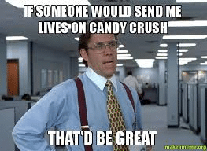
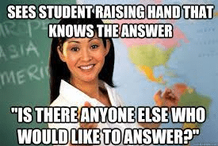
Fixed Interval Examples
Real World Example
When playing a game on your phone, such as candy crush, when you ran out of lives you had to wait 15 entire minutes before you got another one. Your first response of opening the app AFTER that duration had passed produced reinforcement. If you opened it any sooner, you still couldn’t play.
Clinical Example
A classroom teacher is growing tired of giving vocal reminders to a specific student that they can’t always be called on, even if they know the correct answer. The teacher decides to review and implement a fixed interval schedule of 5 minutes.

Slide 26
Fixed Ratio
Fixed Ratio: this schedule requires a fixed amount of responses to occur for a reinforcer. A post-reinforcement pause is often noted when looking at the consistency of responding in this schedule.

Slide 27
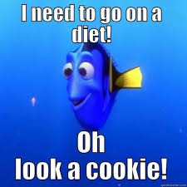
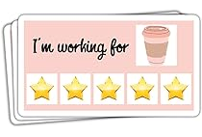
Fixed Ratio Examples
Real World Example
Nicole owns her own cookie business. She only makes what her client’s order and gets paid by the order.
Clinical Example
Leslie, a BCBA introduces a token system to a new student. They initially will reward a token for each individual response. They start with a single token on the board and then give the student a reinforcer break. Over time, Leslie adjusts the number of tokens earned for each working time to eventually go up to 6 tokens.

Slide 28
Variable Interval
Variable Interval: this schedule requires a variable (on average) amount of time to pass and the first completed response after the time has passed produces a reinforcer. This schedule typically produces slow and steady responses that are constant and stable.

Slide 29

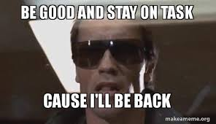
Variable Interval Examples
Real World Example: Joke telling is a prime example of a variable interval schedule of social skills. In some situations you can tell a joke immediately and make people laugh, but at other times you have to read the room and judge how much time should pass before you tell a joke. What makes it hard is that the amount of time that passes is never the same!
Clinical Example
Mary wants to work on a client’s on task behavior. She generates a variable interval schedule of 5 minutes. She reinforces her student’s on task behavior on the first response AFTER the time interval has passed by giving him a bit of attention and social praise.

Slide 30
Variable Ratio
Variable Ratio: this schedule requires a variable (on average) number of responses to occur for a reinforcer. These schedules often produce consistent, steady rates of responding because learners do not know which response will contact reinforcement.

Slide 31
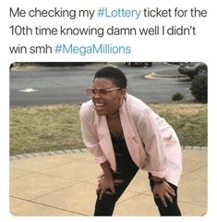
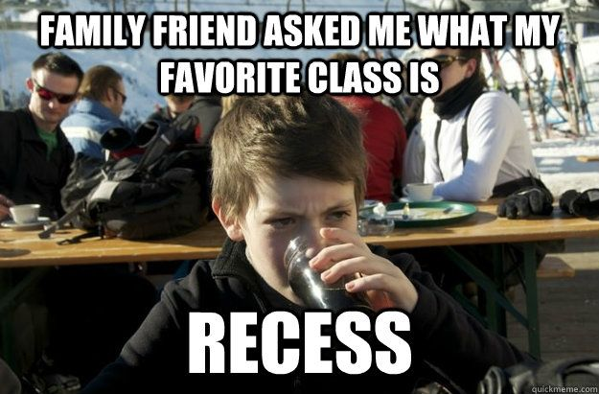
Variable Ratio Examples
Real World Example
You purchase a daily lottery ticket even though you know the chances of winning are slim. There was that one time you won 50$, and a handful of occasions where you won 10$ or a free ticket.
Clinical Example A classroom teacher wants to increase her students turning in their homework. SO, she creates a fixed ratio where students aren't able to tell when they'll be given a reward for turning in their homework. Because of this, more students will turn in their assignments on time than not, especially if the reward is something that the classroom would appreciate like early recess!

Slide 32
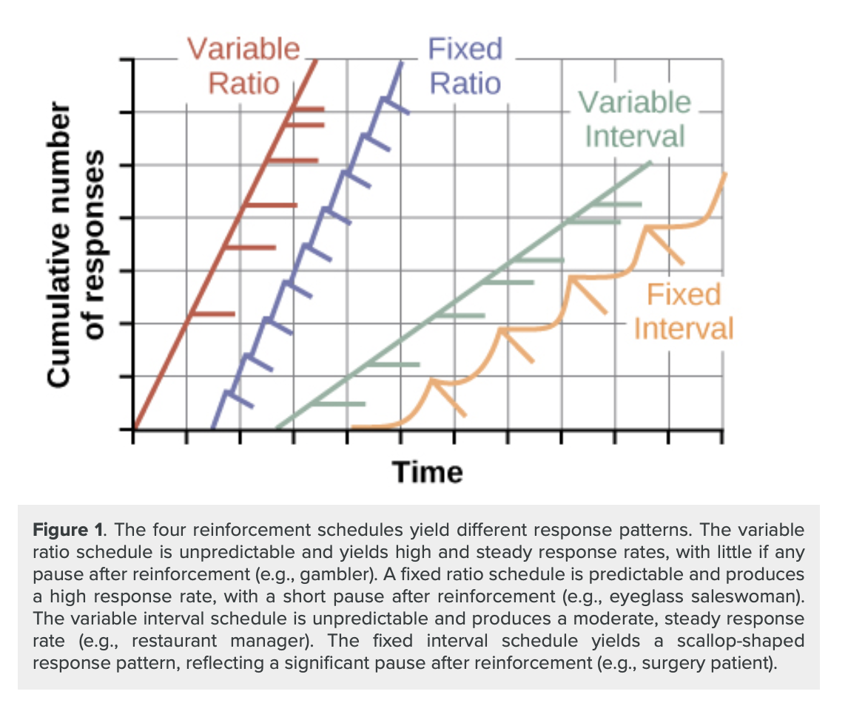

Slide 33
Common Misapplications of Positive Reinforcement
Catching them being inappropriate
Attempting to decrease a behavior without increasing an alternative behavior
Conducting the positive program only following the occurrence of inappropriate behavior
Decreasing demands because of an increase in inappropriate behavior

Slide 34
Extinction
Extinction - goal is to decrease probability of behavior by discontinuing reinforcement
More than just “planned ignoring”
    Ignoring
    Ignore & Redirect
    Block & Redirect
    Guided Compliance

Slide 35
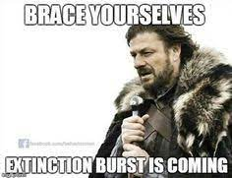
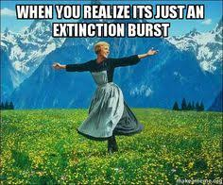
Extinction “Side Effects”
Extinction may first increase or get worse, before it gets better…… Extinction Burst
Extinction may increase aggressive and other emotional behaviors
Should not be implemented alone….important to reinforce an alternative behavior

Slide 36
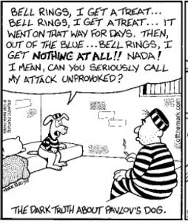

Slide 37
Punishment
Punisher - An event, when presented or removed immediately following behavior, causes behavior to decrease
If, in given situation, a child does something that is immediately followed by punisher, then child is less likely to do same thing again when next encounters situation again

Slide 38
Punishment
Time out
Reprimands
Overcorrection/ positive practice
Loss of preferred item/ activity
Response cost
Protective holds/escorts

Slide 39
Disadvantages of Punishment
Cannot be depended on to produce long-lasting suppression
May provoke escape and aggression
Emotional reactions
Does not teach appropriate behaviors

Slide 40
Contingency Chart
 | Add (+) | Subtract (-)
Increase Behavior | Positive Reinforcement | Negative Reinforcement
Decrease Behavior | Punishment (Type I) | Punishment (Type II)

Slide 41
Questions?

